Slide 1
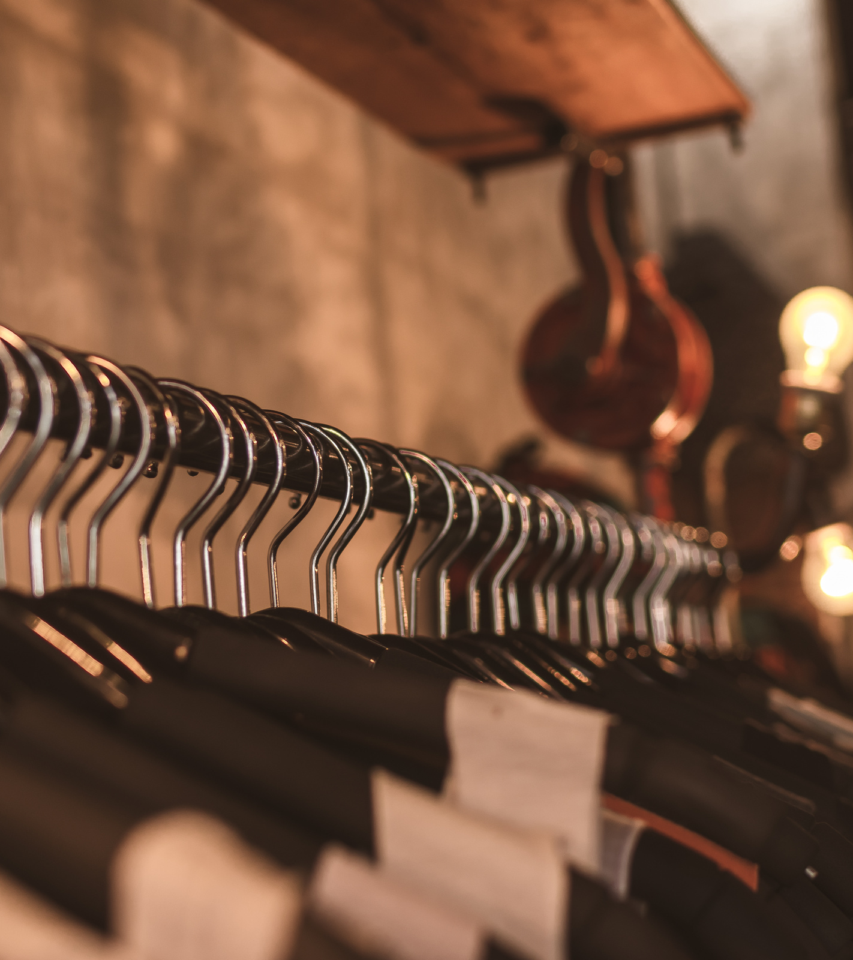
second-
goods
HCI
L801
GANESH EKATATA BUANA
KELLY LANJAYA
NATASHYA AMARTYA
2301861453
2301926806
2201733963

Slide 2
EMPOWERING THE SOCIETY
second-goods empowers the society by civilizing the culture of reusing clothes and reducing the high consumption rate of fashion goods by renting and being a renter.
second-goods
and Binus Strategic Objectives
KNOWLEDGE AND INNOVATION
second-goods raises awareness concerning critical issues in fashion industry and innovates to resolve these issues through movements for zero waste by reusing secondhand clothes.

Slide 3


Our concerns.
FASHION INDUSTRY
SECOND MOST POLLUTING INDUSTRY IN THE PLANET
The fashion industry produces 10% of all humanity’s carbon emissions, huge amounts of toxic waste released directly into water streams and is the second-largest consumer of the world’s water supply.
FAST FASHION CULTURE
Treatment of clothes as fast moving consumer goods creating huge problems for the environment. Clothes are only worn once or a few times, then discarded. The equivalent of one garbage truck full of clothes is burned or dumped in a landfill every second.
Notes:
https://ehef.id/post/global-challenges-and-opportunities-fashion/en
June 13, 2021
https://www.weforum.org/agenda/2020/01/fashion-industry-carbon-unsustainable-environment-pollution/
January 31, 2020

Slide 4
Our solution.
Civilizing movements for zero waste, reducing, reusing, and recycling clothing goods through second-goods (notably reusing). Our platform provides ease of access to rent a wide variety of used clothing goods with guaranteed quality, promoting the movement and suppressing the high consumption of fashion industry.
REDUCE, REUSE, RECYCLE.

Slide 5
RENT FOR ANY OCCASSION
second-goods offer you various types of clothing that you can wear at any occassion.
What we offer on second-goods
TRY-ON MODELS
Our platform provides try-on clothes on models with different body types, sizes, and skin color.
SCHEDULE YOUR ORDER
You can book anytime based on your needs, as long as it is available.

Slide 6
HTTPS://WWW.FIGMA.COM/PROTO/FJWA1JR4LZCI8T2IZKDYBC/HCI-PROJECT-LECTURE?PAGE-ID=0%3A1&NODE-ID=726%3A86&VIEWPORT=49%2C-444%2C0.11603465676307678&SCALING=MIN-ZOOM&HIDE-UI=1
Prototype Link

Slide 7
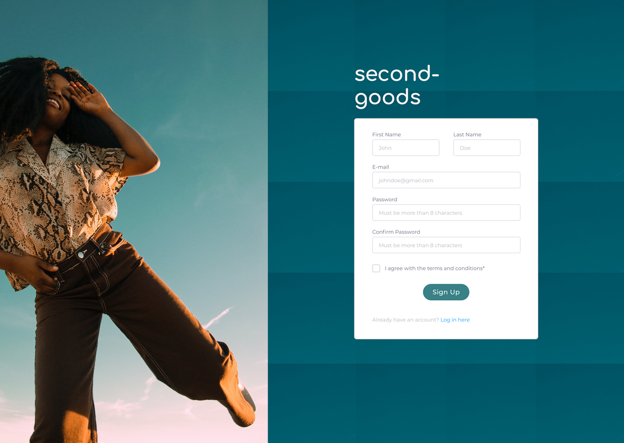
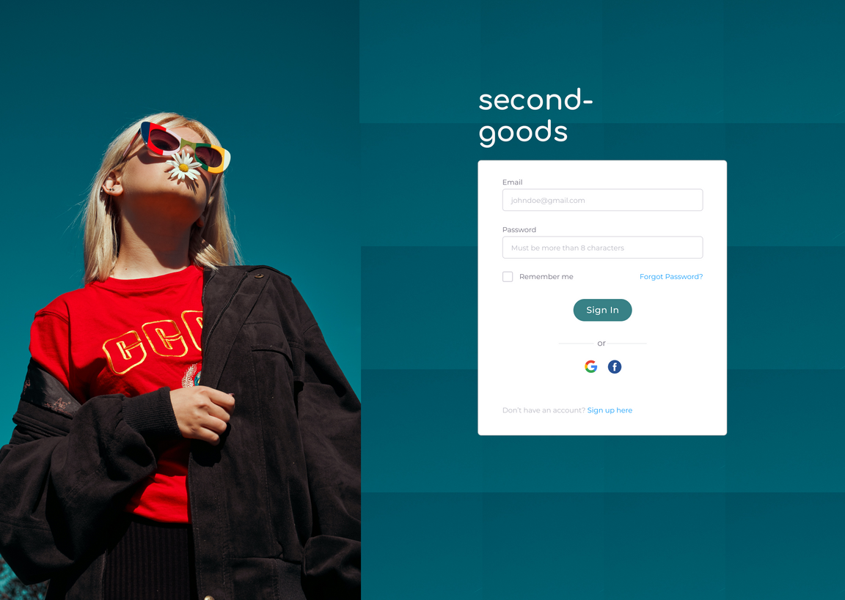
LOGIN
Log in using either a registered account, a Google account, or a Facebook account.
SIGN UP
Sign up by filling in the required data and accepting the terms and conditions.

Slide 8
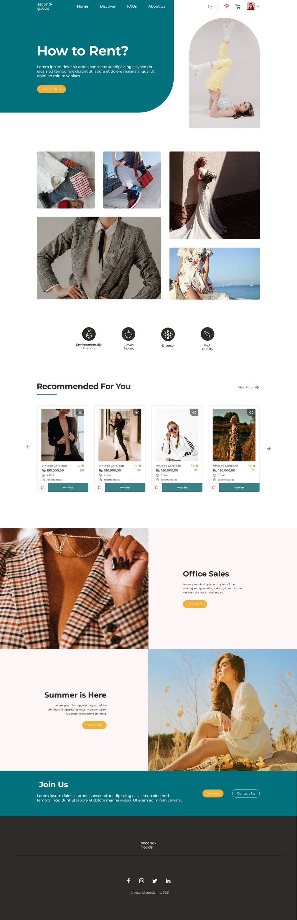
HOME
second-goods offers can be found on the home page, from categories of clothing, our services, recommended clothes for you, and limited sales.

Slide 9
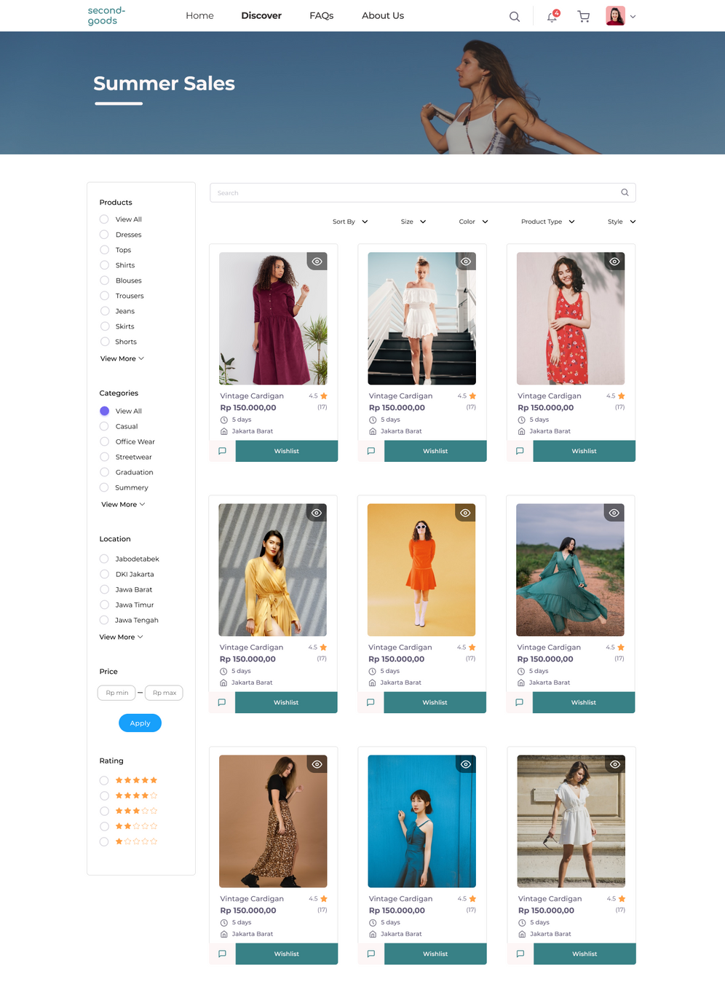
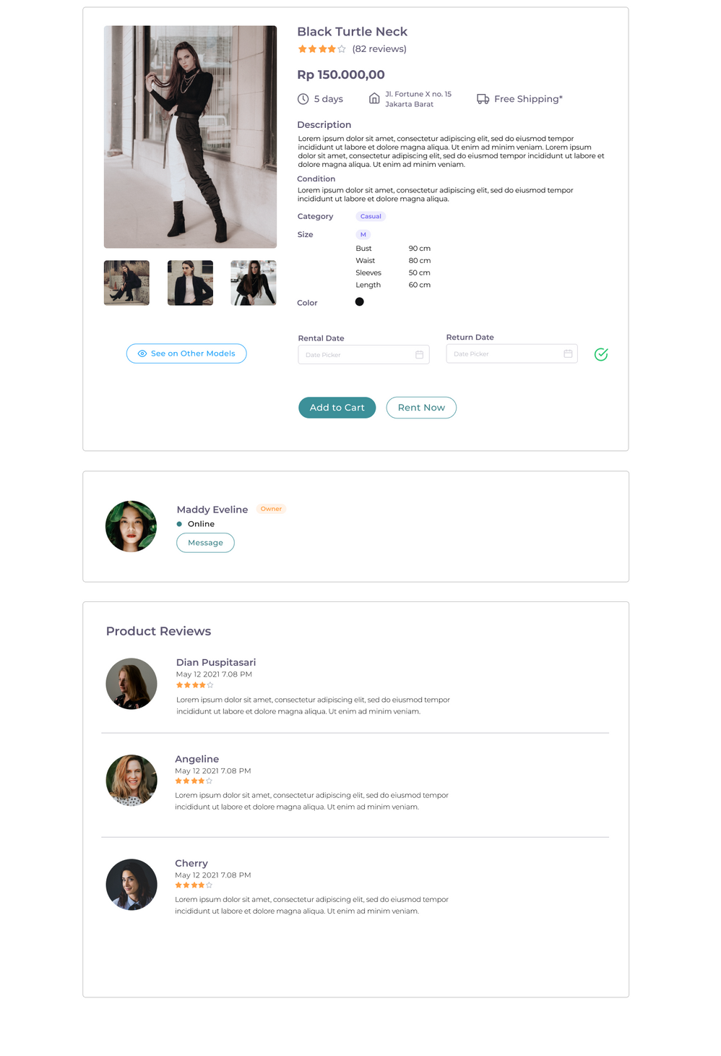
DISCOVER
PRODUCT'S DETAILS
Find the best fit by searching and filtering based on your preferences.
You can find prices, description, sizes, available dates, owner profile, and reviews.

Slide 10
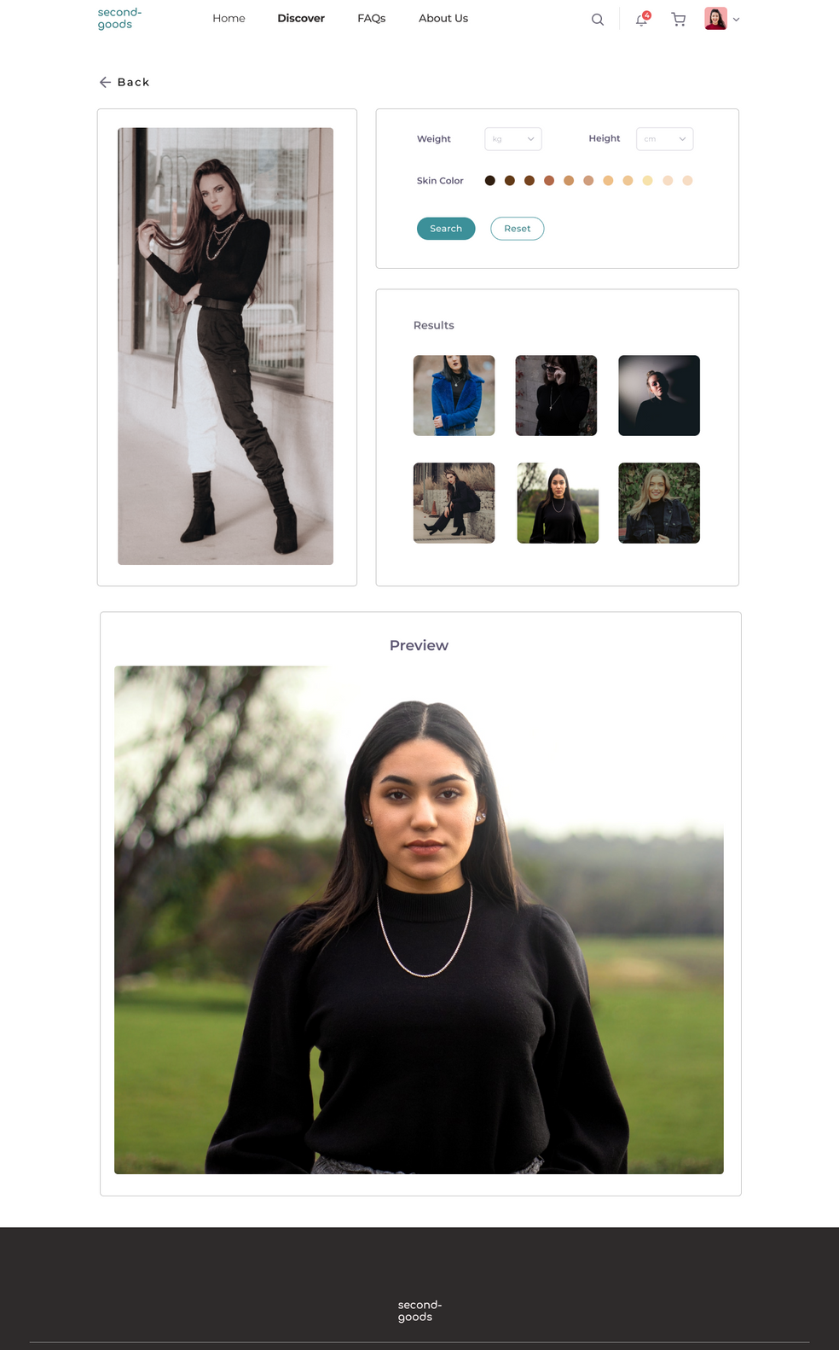
TRY-ON
If you are confused on what the clothes might look on you, you can search on models that fit most similar to your preferences.

Slide 11
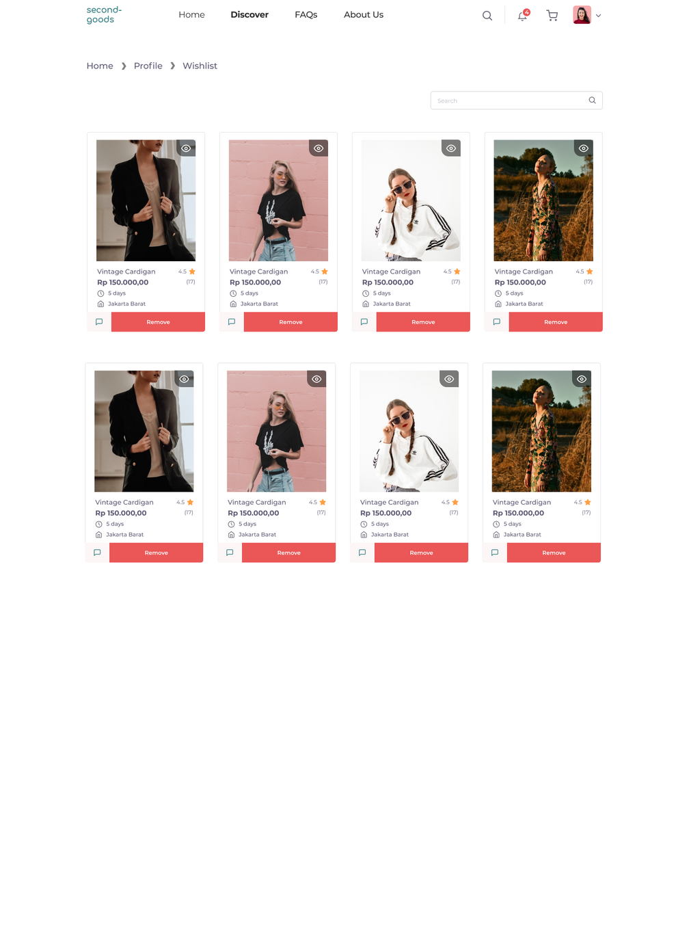
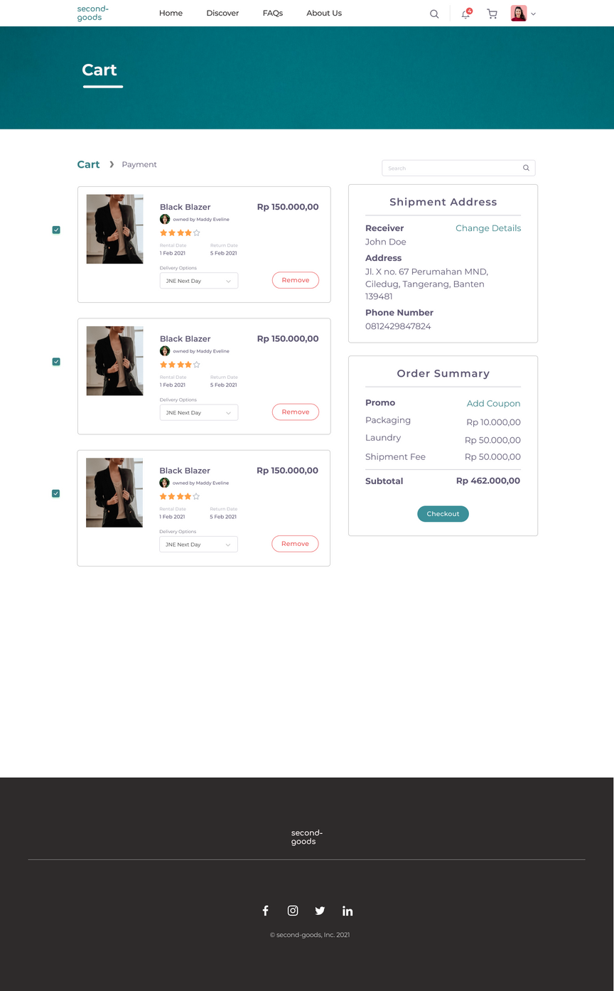
WISHLIST
CART
Save your most wanted clothing to rent.
Shows list of products that you want to rent, with order summary and shipment address.

Slide 12
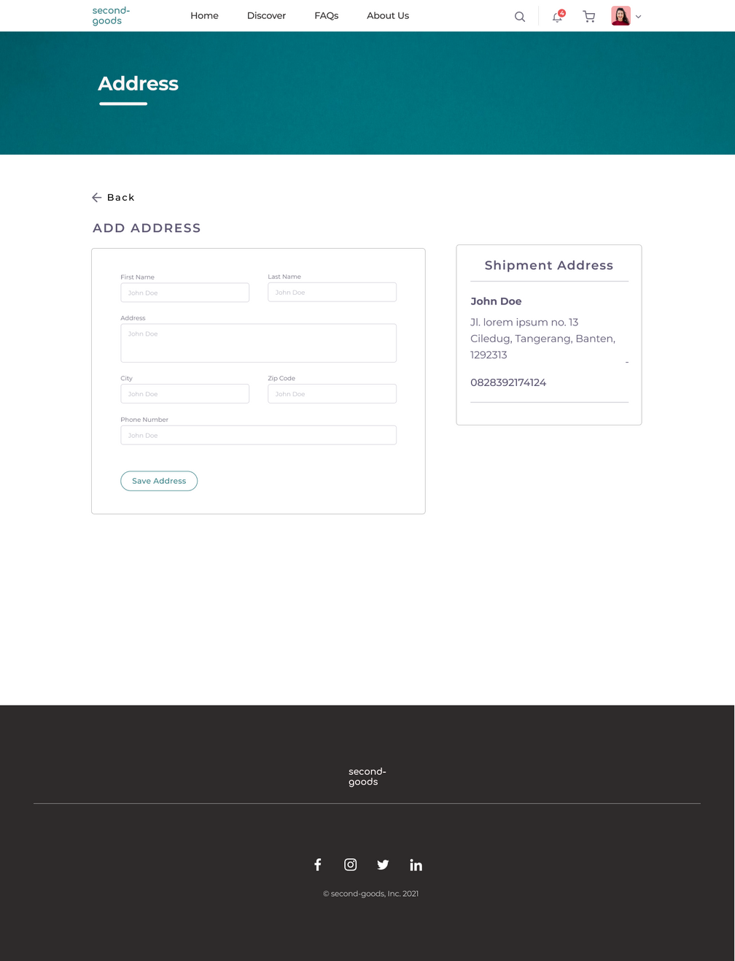
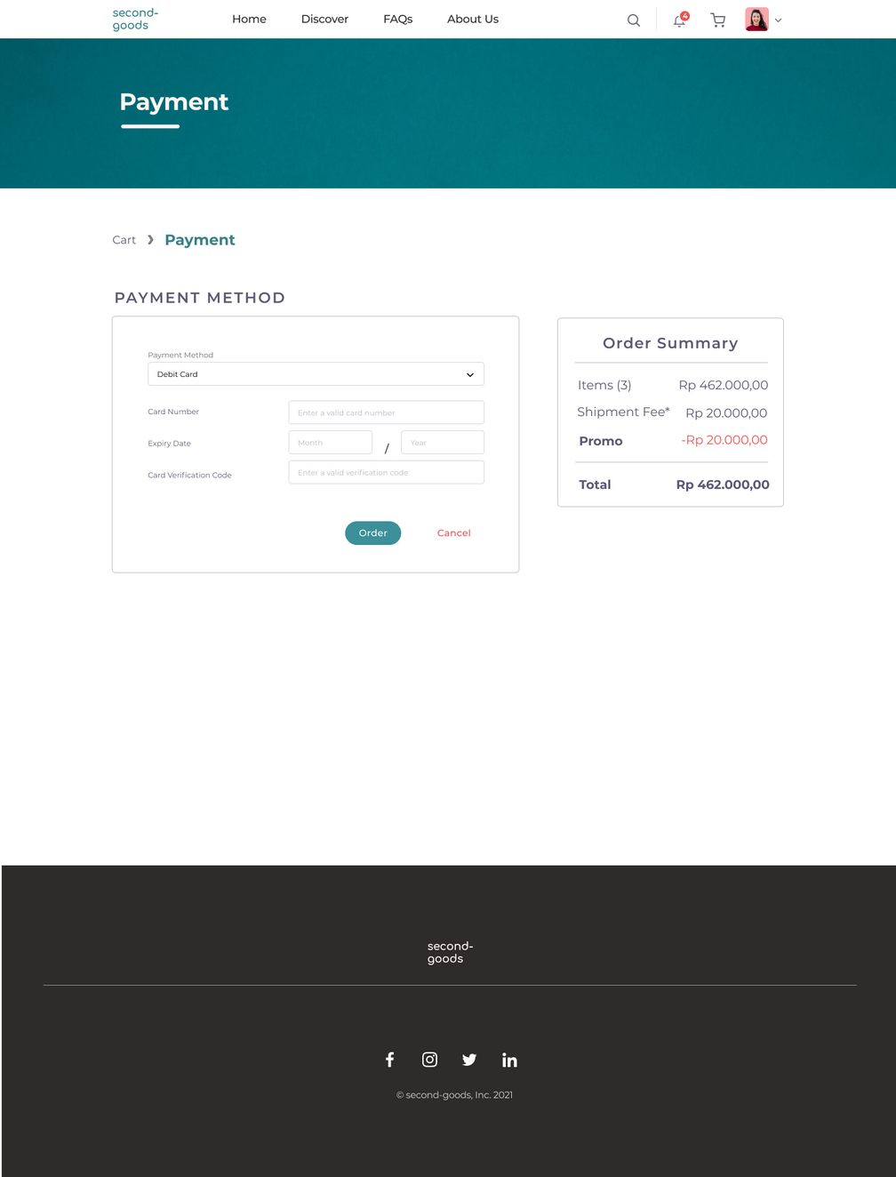
ADD/CHANGE ADDRESS
PAYMENT
Add/change shipment address with other information such as phone number.
Choose the payment method if you are ready to order.

Slide 13
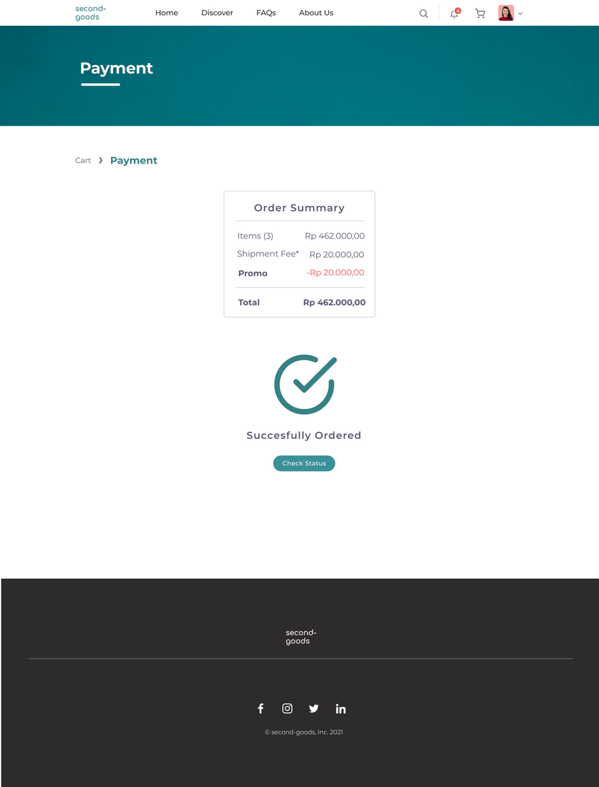
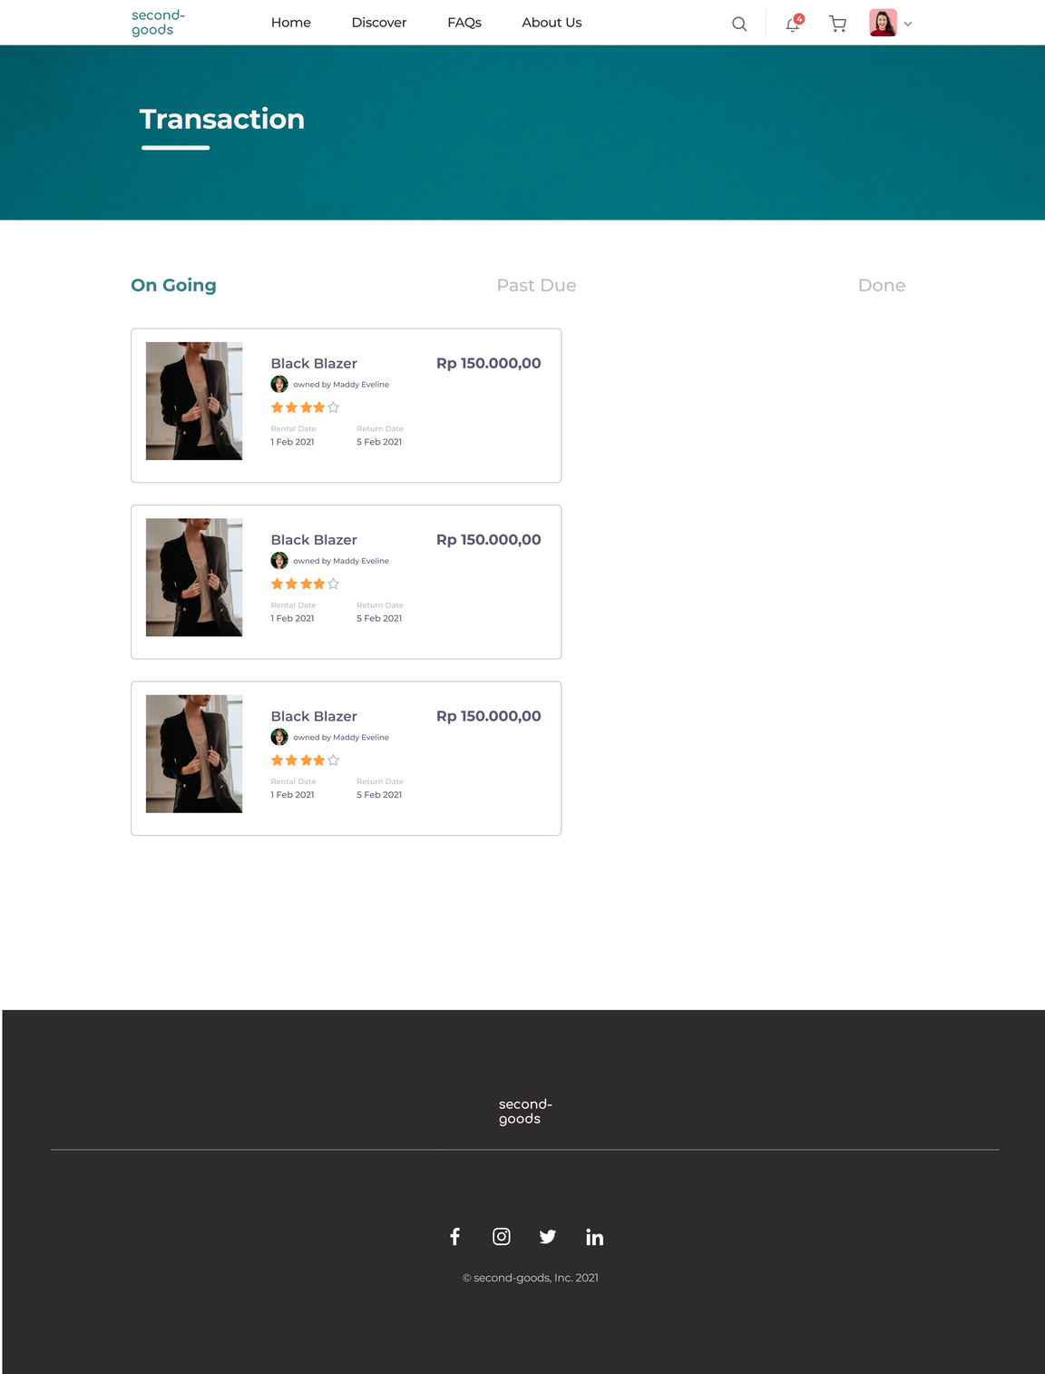
SUCCESS ORDER
TRANSACTION
Shows a successfully processed order along with the order summary.
Shows list of on going, past due, and done transactions along with their details.

Slide 14
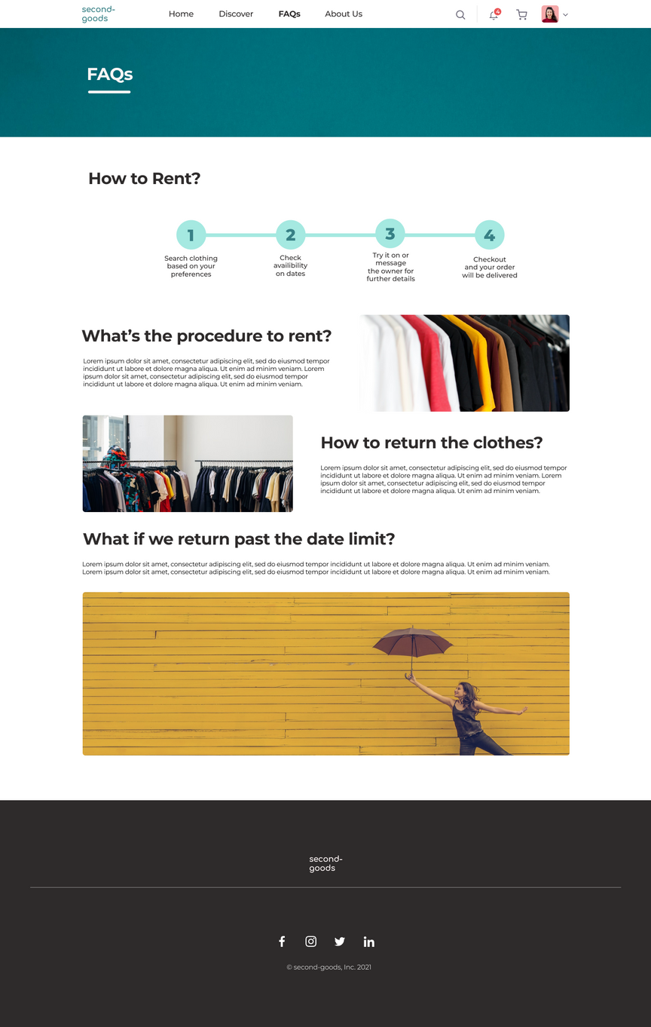
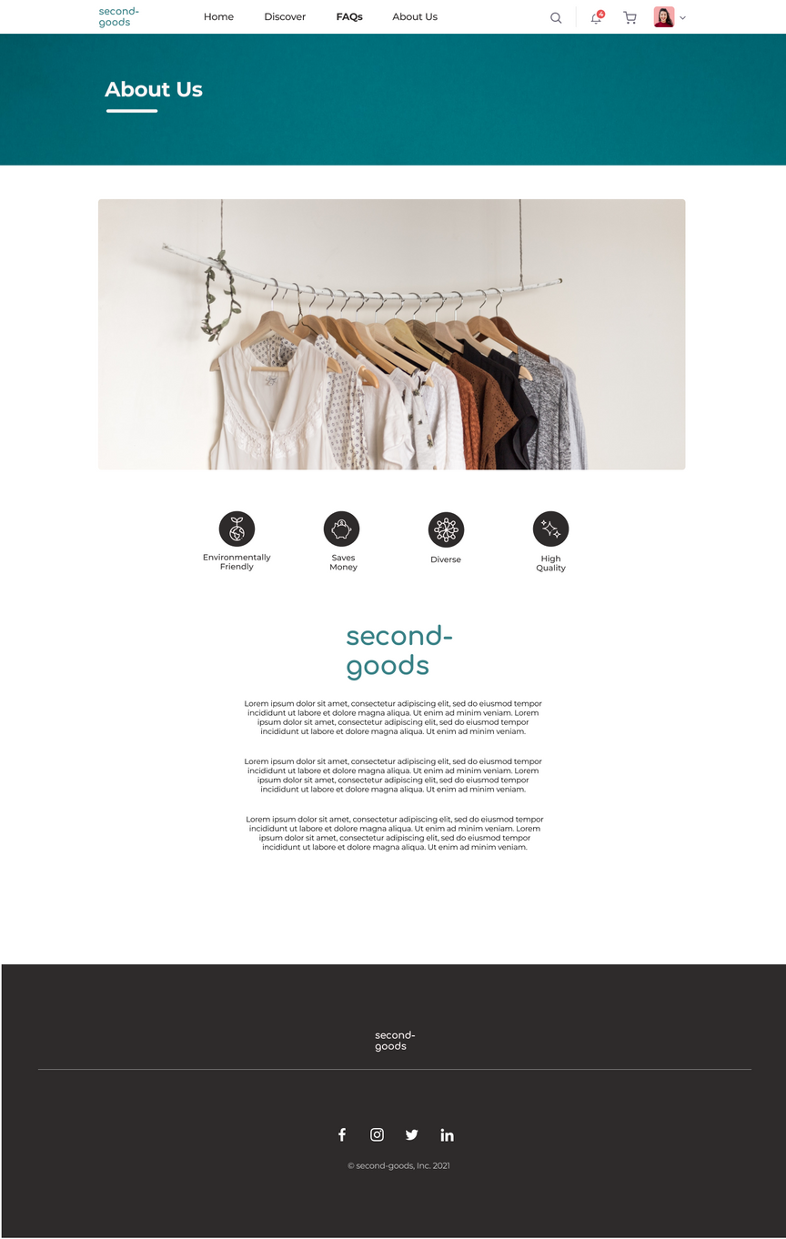
FAQ
ABOUT US
Frequently asked questions are answered here.
All about second-goods' history, mission, and vision.

Slide 15
EUROPEAN HIGH EDUCATION FAIR
JUNE 13, 2021
https://ehef.id/post/global-challenges-and-opportunities-fashion/en
References
WORLD ECONOMIC FORUM
JANUARY 31, 2020
https://www.weforum.org/agenda/2020/01/fashion-industry-carbon-unsustainable-environment-pollution/

Slide 16


Thank you.

